Slide 1


Using Copilot Pro with Microsoft Word
Notes:
https://copilot.cloud.microsoft/en-US/copilot-word

Slide 2




Notes:
https://www.youtube.com/channel/UC35ZpwldGw7ZJ5R-2sLijzw

Slide 3
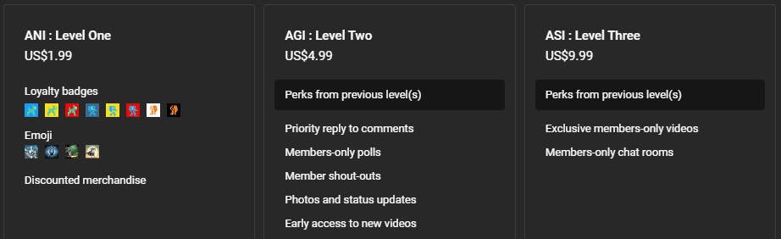

Membership has its privileges
Notes:
https://www.youtube.com/channel/UC35ZpwldGw7ZJ5R-2sLijzw/join

Slide 4

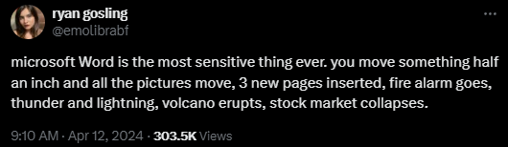

Slide 5
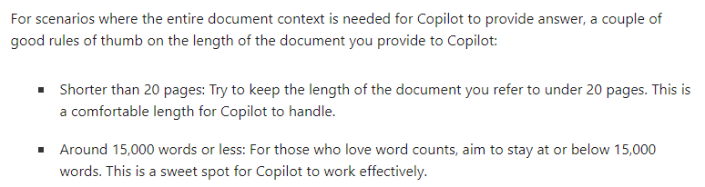
Notes:
https://support.microsoft.com/en-us/topic/keep-it-short-and-sweet-a-guide-on-the-length-of-documents-that-you-provide-to-copilot-66de2ffd-deb2-4f0c-8984-098316104389

Slide 6
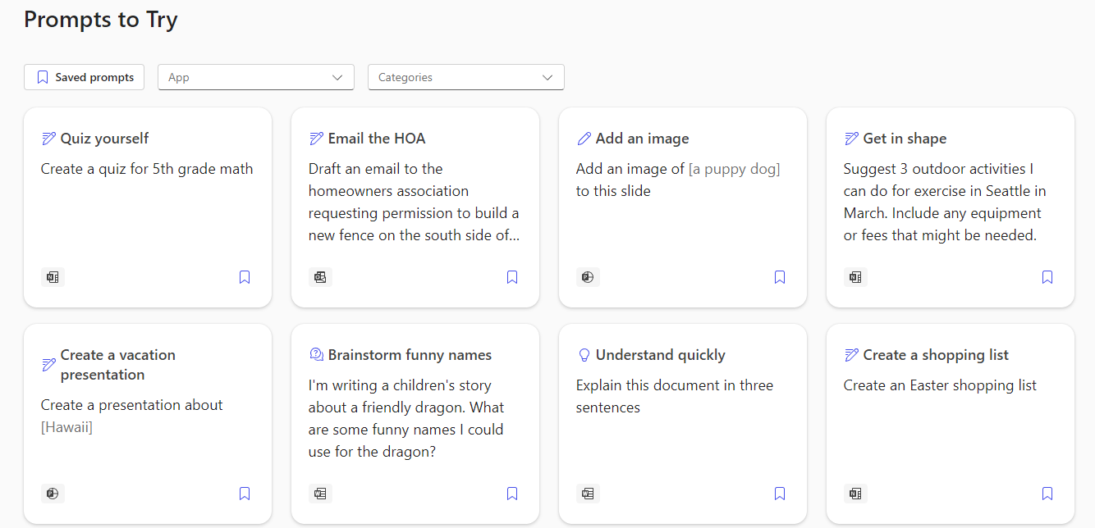
Notes:
https://copilot.cloud.microsoft/en-US/prompts/all

Slide 7

Drafting a Document
Notes:
https://support.microsoft.com/en-us/office/draft-and-add-content-with-copilot-in-word-069c91f0-9e42-4c9a-bbce-fddf5d581541
Write a paper on the advantages of using Copilot with Microsoft Word that I can give to my boss to justify the monthly cost of $20 a month for Copilot Pro or $30 month for Copilot for Business

Slide 8

Rewriting Text
Notes:
https://support.microsoft.com/en-us/office/transform-your-content-with-copilot-in-word-923d9763-f896-4da7-8a3f-5b12c3bfc475

Slide 9

Create a table from Text
Notes:
https://support.microsoft.com/en-us/office/transform-your-content-with-copilot-in-word-923d9763-f896-4da7-8a3f-5b12c3bfc475
Copilot costs: Copilot for Business $30.00 user/month, Microsoft Copilot Pro $20.00 user/month
Copilot (Free)
For everyone who wants to find robust information, create unique content, and get things done faster.
With your free Microsoft account, you can:
Use Copilot on the web and in Windows, macOS, and iPadOS
Access GPT-4 and GPT-4 Turbo during non-peak times
Use text, voice, and images in conversational search
Create and edit AI images with 15 boosts per day with Designer
Use plug-ins and GPTs
Copilot Pro and Business
For those who want faster performance, enhanced creativity capabilities, and a supercharged Copilot experience.
This monthly subscription includes everything in Copilot, plus you can:
Get priority access to GPT-4 and GPT-4 Turbo even during peak times for faster performance
Build your own Copilot GPTs tailored to your individual needs and interests
Use Copilot in productivity apps like Word, Excel, PowerPoint, and Outlook (Microsoft email address required)
Generate unique images and then enhance your creations using 100 daily boosts with Designer

Slide 10

Ask questions about your document
Notes:
Summarize this doc
Why should I care about copilot for my employees?
Who was the first president of the United States?

Slide 11
